Slide 1
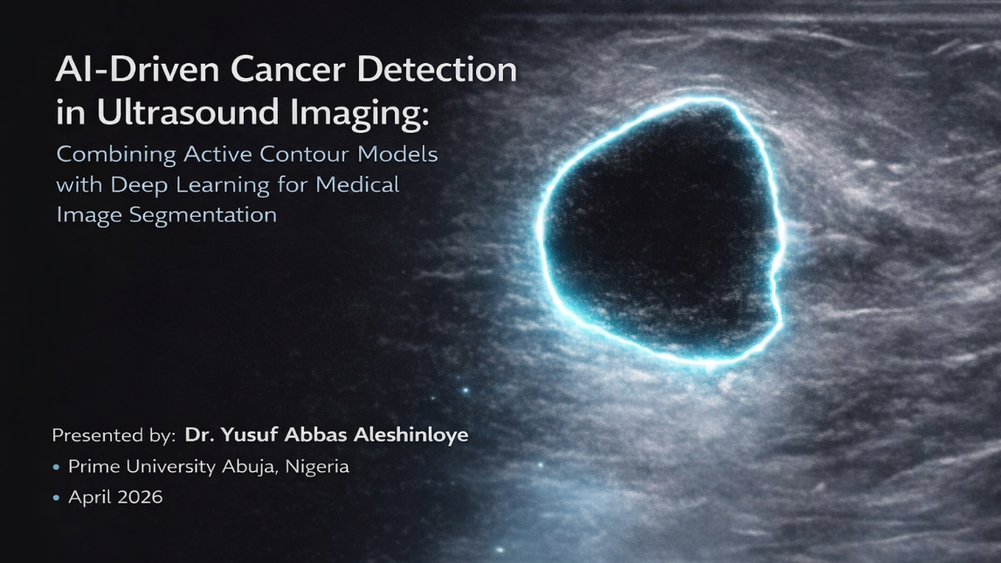

Slide 2
Al-Drjven Cancet Detection in Ultrasound hnaging: Combining Active Contour Models with Deep Learning for Medical Image Segmentation.

